Slide 1
MODULE 2: BASELINE ASSESSMENT
Session 9: Livelihood Strategies
Notes:
Livelihood Strategies

Slide 2
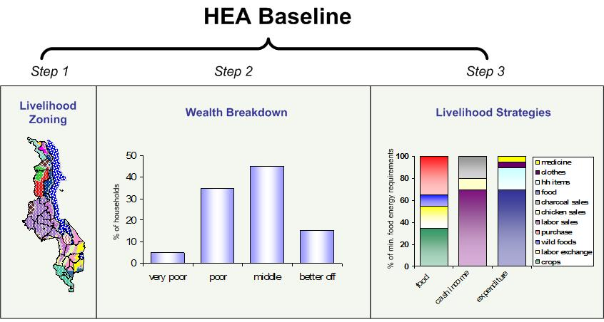
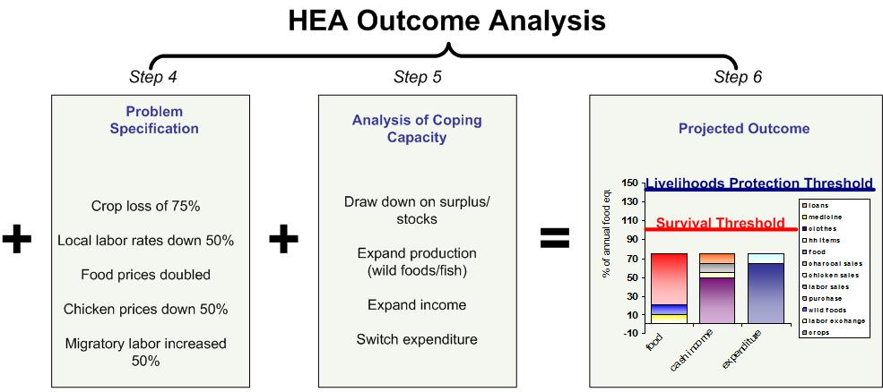
What are Livelihood Strategies?
The task of quantifying livelihood strategies is the last step in compiling the HEA baseline
Session 9: Livelihood Strategies
Notes:
Livelihood Strategies
Note: The household is taken as the unit of reference because it is by far the chief unit through which populations anywhere operate for production, sharing of income and consumption.

Slide 3
What are Livelihood Strategies?
A livelihood is the sum of ways in which households obtain the things necessary for life, both in good years and in bad
Session 9: Livelihood Strategies
Notes:
Livelihood Strategies
Note: The household is taken as the unit of reference because it is by far the chief unit through which populations anywhere operate for production, sharing of income and consumption.

Slide 4
What are Livelihood Strategies?
These necessities include :
Food
Water
Shelter
Clothing
Health care
Education
Session 9: Livelihood Strategies
Notes:
Livelihood Strategies

Slide 5
What are Livelihood Strategies?
Livelihood strategies, therefore, are the specific means by which households obtain these basic necessities
Session 9: Livelihood Strategies
Notes:
Livelihood Strategies

Slide 6
What are Livelihood Strategies?
In HEA, the analysis of livelihood strategies includes an investigation into how people obtain their food and cash, and what they need to spend their money on
Session 9: Livelihood Strategies
Notes:
Livelihood Strategies

Slide 7
Why do we care about Livelihood Strategies?
If we know how people get what they need, we will also know which things will affect that access
Cash needed for..
comes from..
Affected by…
School fees
Weeding labor
Drop in daily wages
Session 9: Livelihood Strategies
Notes:
Livelihood Strategies

Slide 8
Why do we care about Livelihood Strategies?
Knowing about access
allows us to link hazards
with effects
Effect
Access
Hazard
Cash needed for..
comes from..
Affected by…
Weeding labor
Drop in daily wages
School fees
Session 9: Livelihood Strategies
Notes:
Livelihood Strategies

Slide 9
How do we find out about Livelihood Strategies?
Because there is a limited set of options for obtaining food and cash, it is possible to systematically explore each option to find out:
How much food or income does the option provide?
Session 9: Livelihood Strategies
Notes:
Livelihood Strategies

Slide 10
How do we find out about Livelihood Strategies?
Because there is a limited set of options for obtaining food and cash, it is possible to systematically explore each option to find out:
When in the year is the option pursued?
Session 9: Livelihood Strategies
Notes:
Livelihood Strategies

Slide 11
How do we find out about Livelihood Strategies?
Because there is a limited set of options for obtaining food and cash, it is possible to systematically explore each option to find out:
Who in the household pursues the option?
Session 9: Livelihood Strategies
Notes:
Livelihood Strategies

Slide 12
How do we find out about Livelihood Strategies?
Because there is a limited set of options for obtaining food and cash, it is possible to systematically explore each option to find out:
Is the option expandable in a bad year?
Session 9: Livelihood Strategies
Notes:
Livelihood Strategies

Slide 13
How do we find out about Livelihood Strategies?
How do people get their food?
Own crop production
Own livestock production
Wild foods, fish and game
Purchase
Exchange (labour or goods for food)
Gifts and loans
Session 9: Livelihood Strategies
Notes:
Livelihood Strategies

Slide 14
How do we find out about Livelihood Strategies?
How do people get their cash?
Sale of crops
Sale of livestock production (milk, ghee, live animals, hides)
Sale of wild foods, fish and game
Employment (casual labour, salaried employment, remittances)
Self-employment (firewood, charcoal, handicrafts, etc.)
Small business and trade (purchase and resale of goods)
Other (gifts, loans, etc.)
Session 9: Livelihood Strategies
Notes:
Livelihood Strategies

Slide 15
How do we find out about Livelihood Strategies?
What do people need to buy?
Staple (cheapest kilojoules)
Minimum non-food (e.g. salt, soap, water, kerosene for cooking, etc.)
Livelihoods protection (health, school, ag. inputs, vet drugs, etc)
Other (money spent on non-essential, discretionary items)
Session 9: Livelihood Strategies
Notes:
Livelihood Strategies
Staple: The amount of money spent on basic staple foods, i.e. those providing the bulk of food energy at minimum cost.
Minimum non-food: cost of preparing and consuming food plus any cash expenditure on water for human consumption. This is the amount of money that cannot, except in the most extreme conditions, be switched to staple food purchases.
Livelihoods protection: The amount of money required to protect existing patterns of livelihoods, i.e. the amount that must be spent on items that are essential in terms of either i) maintaining access to basic services (e.g. routine medical and schooling expenses) or ii) the maintenance of livelihoods in the medium to longer term (e.g. purchase of seeds, fertilizer, veterinary drugs, etc.) or iii) the maintenance of a minimum acceptable standard of living (e.g. purchase of basic clothing, coffee/tea, etc.)
Other: The amount of money left over for expenditure on other non-essential or discretionary items, such as better quality clothing, more than the minimum quantity of meat and vegetables, cigarettes, etc.

Slide 16
Adding Things Up: Beyond the Checklist
Sources of food need to add up to around 8800 kJ pppd
Sources of income need to make sense given production and labour available in household
Session 9: Livelihood Strategies
Notes:
Livelihood Strategies
Staple: The amount of money spent on basic staple foods, i.e. those providing the bulk of food energy at minimum cost.
Minimum non-food: cost of preparing and consuming food plus any cash expenditure on water for human consumption. This is the amount of money that cannot, except in the most extreme conditions, be switched to staple food purchases.
Livelihoods protection: The amount of money required to protect existing patterns of livelihoods, i.e. the amount that must be spent on items that are essential in terms of either i) maintaining access to basic services (e.g. routine medical and schooling expenses) or ii) the maintenance of livelihoods in the medium to longer term (e.g. purchase of seeds, fertilizer, veterinary drugs, etc.) or iii) the maintenance of a minimum acceptable standard of living (e.g. purchase of basic clothing, coffee/tea, etc.)
Other: The amount of money left over for expenditure on other non-essential or discretionary items, such as better quality clothing, more than the minimum quantity of meat and vegetables, cigarettes, etc.

Slide 17
Adding Things Up: Beyond the Checklist
Total expenditure needs to balance with total income.
Session 9: Livelihood Strategies
Notes:
Livelihood Strategies
Staple: The amount of money spent on basic staple foods, i.e. those providing the bulk of food energy at minimum cost.
Minimum non-food: cost of preparing and consuming food plus any cash expenditure on water for human consumption. This is the amount of money that cannot, except in the most extreme conditions, be switched to staple food purchases.
Livelihoods protection: The amount of money required to protect existing patterns of livelihoods, i.e. the amount that must be spent on items that are essential in terms of either i) maintaining access to basic services (e.g. routine medical and schooling expenses) or ii) the maintenance of livelihoods in the medium to longer term (e.g. purchase of seeds, fertilizer, veterinary drugs, etc.) or iii) the maintenance of a minimum acceptable standard of living (e.g. purchase of basic clothing, coffee/tea, etc.)
Other: The amount of money left over for expenditure on other non-essential or discretionary items, such as better quality clothing, more than the minimum quantity of meat and vegetables, cigarettes, etc.

